Slide 1

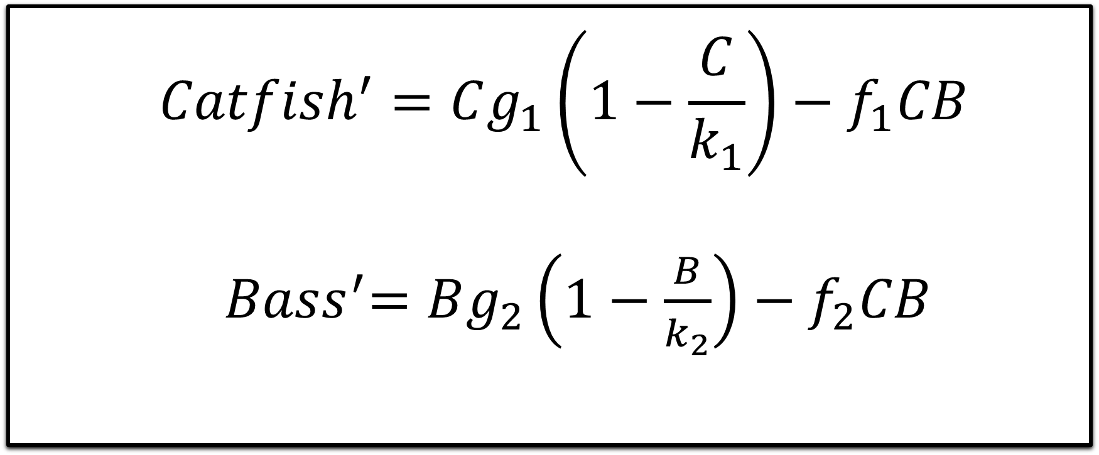
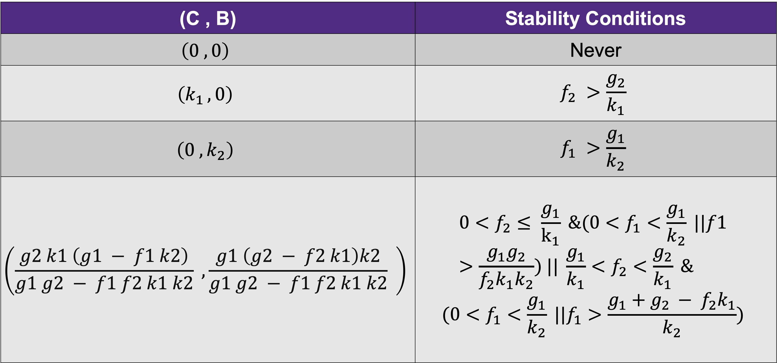
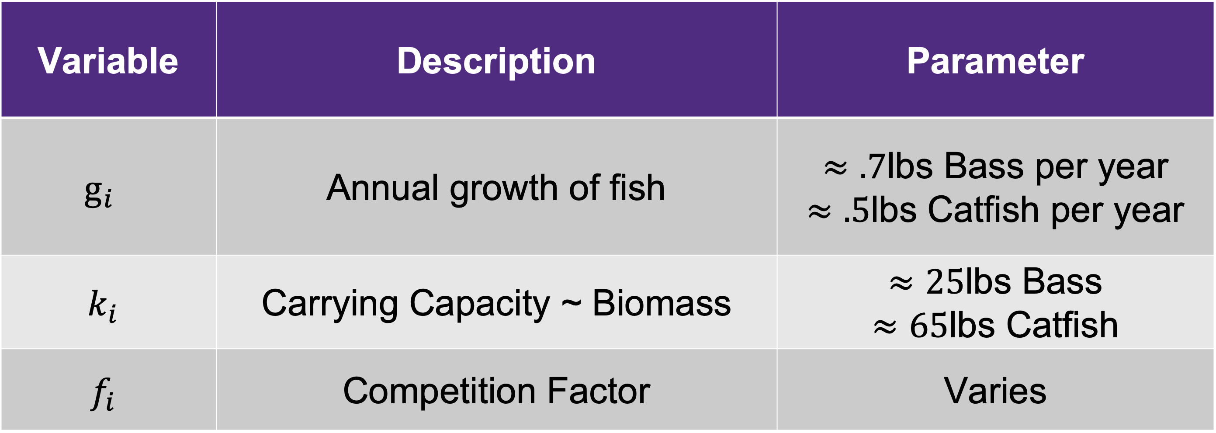
Predator-Prey Model for
Largemouth Bass and Channel Catfish
Trace Patterson
Advisor: Dr. Christopher Mitchell
Introduction
Lotka-Volterra Competition
Variable | Description | Parameter
$$g_{i}$$ | Annual growth of fish | $≈.7$lbs Bass per year $≈.5$lbs Catfish per year
$$k_{i}$$ | Carrying Capacity ~ Biomass | $≈25$lbs Bass $≈65$lbs Catfish
$$f_{i}$$ | Competition Factor | Varies
Largemouth Bass and Channel Catfish are among the most common sport fish in Texas. We model these fish via differential equations and evolve this model to try to solve some unanswered questions about the interactions of these species.
$${Catfish}^{′}=Cg_{1}\left(1−\frac{C}{k_{1}}\right)−f_{1}CB$$
${ Bass}^{′}=Bg_{2}\left(1−\frac{B}{k_{2}}\right)−f_{2}CB$
Situation Direction Fields
Assumptions
Similar Sizes of Fish
Constant Water Level
½ Acre Pond ~ 15 ft depth
Ample Amount of Insects
No Predators
Natural Mortality
Quality of Water is Sufficient
Equilibrium
Conclusions
Future Works
(C , B) | Stability Conditions
$$\left(0 , 0\right)$$ | Never
$$\left(k_{1 }, 0\right)$$ | $$f_{2} >\frac{g_{2}}{k_{1}}$$
$$\left(0 , k_{2}\right)$$ | $$f_{1} >\frac{g_{1}}{k_{2}}$$
$$\left(\frac{g2 k1 \left(g1 − f1 k2\right)}{g1 g2 − f1 f2 k1 k2} ,\frac{g1 \left(g2 − f2 k1\right)k2}{g1 g2 − f1 f2 k1 k2} \right)$$ | $$0<f_{2}≤ \frac{g_{1}}{k_{1}} \&(0<f_{1}<\frac{g_{1}}{k_{2}} ||f1>\frac{g_{1}g_{2}}{f_{2}k_{1}k_{2}}) || \frac{g_{1}}{k_{1}}<f_{2}<\frac{g_{2}}{k_{1}} \&$$ $$(0<f_{1}<\frac{g_{1}}{k_{2}} ||f_{1}>\frac{g_{1}+g_{2 }− f_{2}k_{1}}{k_{2}})$$
If competition is within these specific intervals the species will co-exist
Further research concluded that for a ½ -acre pond, one should expect similar results
Many variables impact these species that are not included in this model.
Include optimal feeding rates in relation to deadly loss of oxygen levels.
Water quality effects on growth and competition
Implement tournament and/or production harvest rates
Largemouth Bass (Micropterus salmoides)
Channel Catfish (Ictalurus punctatus)

